Slide 1
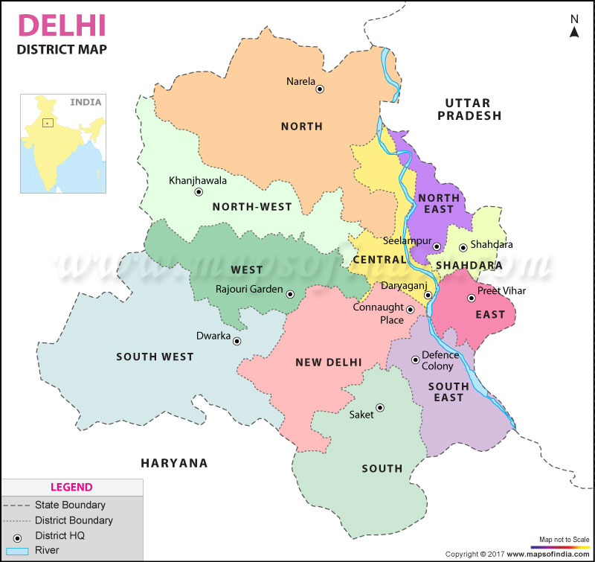
Battle of Neighbourhood - Delhi

Slide 2

Objective
Delhi, India’s capital territory, is a massive metropolitan area in the country’s north
As being the Capital of India, attract people from all over India with different requirement i.e. Professionals, Students, Administrative officers, Patients etc.
As people migrate they may not have any idea what different location offers
Help people to provide details of location which meets their objective
Select potential locations indexed by neighborhoods

Slide 3
Steps
Search and arrange Delhi spatial data in csv format
Index geographical information of Delhi by Neighborhoods
Using Foursquare API collect venues details for each neighborhood
Create cluster making the categories as base feature
Analyze the clusters and segment the clusters
Analysis of neighborhood based upon the top venues in that particular neighborhood

Slide 4
Libraries
Pandas, Numpy: For data manipulation and analysis
Scipy: For applying clustering and segmentation algorithms
Geopy: To locate the coordinates of addresses, cities, countries, and landmarks
Matplotlib, Folium: To plot charts and graphs
Requests, Urllib: Libraries to retrieve data and handle http exchange with the Foursquare API

Slide 5
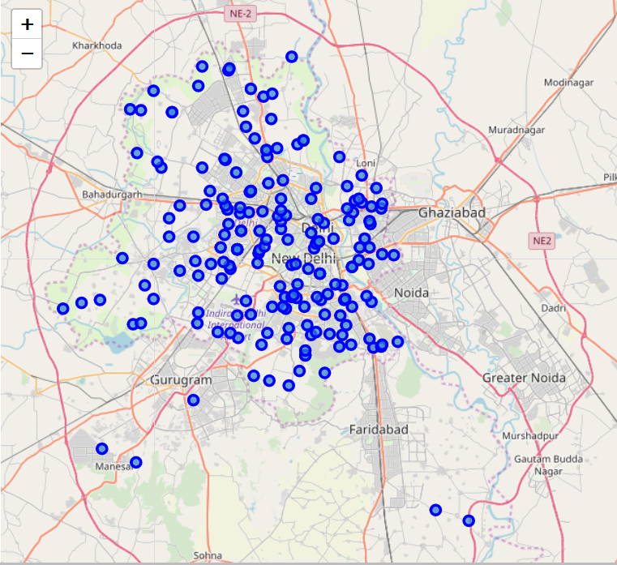
Points of Neighborhoods

Slide 6
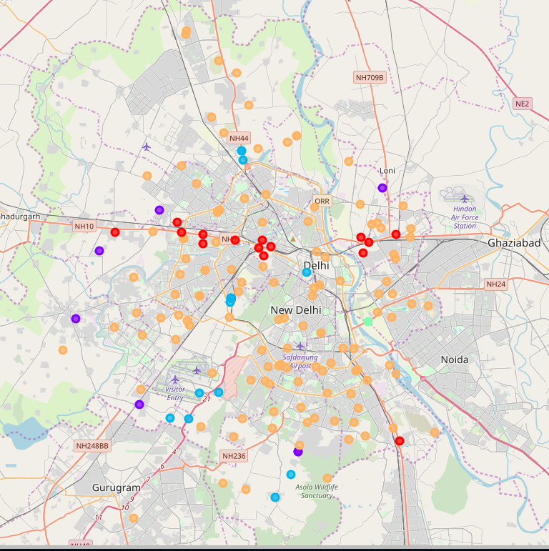
Five Clusters in Delhi

Slide 7
Attributes of Clusters
Cluster Colour Index
Cluster | Colour Index
Cluster 1 | RED
Cluster 2 | BLUE
Cluster 3 | INDIGO
Cluster 4 | GREEN
Cluster 5 | ORANGE
Modes of Venue Categories
Cluster | Venue Category
Cluster 1 | Train Transport, Restaurant, Pizza Stores
Cluster 2 | ATM, Women Store, Fabric Shop
Cluster 3 | Hotel, Snack Place, Cafe
Cluster 4 | Botanical Garden, Women’s Store, Fabric Shop
Cluster 5 | Various Types of Restaurants, Stadium, Tourist Spots

Slide 8
Comparison
Cluster | Comparison
Cluster 1 | Good if someone need public transport services, budget outings
Cluster 2 | Basic amenities with family daily needs
Cluster 3 | More like a High class outing
Cluster 4 | Good for who likes to stay near park and for nature refresh
Cluster 5 | Good for those who are interested in sports activities

Slide 9
Thank You
Battle of Neighbourhood – Delhi
Mission Accomplished

